Slide 1


Dmart Sales Dashboard
Sales, Customer Behavior, Pricing & Operations Analysis

Slide 2
Introduction
This project is based on DMart’s Sales and the dataset are taken from Capstone Project provided by ITVedant.
The main goal is to use Power BI to study over 25,000 sales records and find useful insights that can help DMart make better business decisions.
Key Focus Areas:
To understand customer behavior — like their age, gender, and buying patterns.
To find which products sell the most and bring the highest revenue.
To check how well DMart’s operations work — including shipping, payments, and order status.
To build an interactive Power BI dashboard that makes all this data easy to explore and understand.
This analysis helps DMart improve sales performance, increase customer satisfaction,
and make daily operations faster and more efficient with clear, real-time visual insights

Slide 3




Business Objective
Sales & Trends
Revenue Drivers
Understand customer behavior patterns
Identify key performance factors
Fulfillment
Reduce Issues
Improve order efficiency
Lower cancellations & pending orders

Slide 4
Key Performance Metrics
₹ 3.20M
4.3K
₹743.32
1.44%
Total Revenue
Total Orders
Avg Order Value
Cancellation Rate
150.65
3.02
Avg Delivery Days
Avg Rating

Slide 5
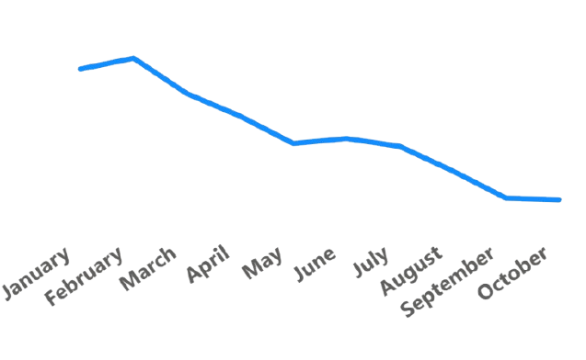
Monthly Sales Trend
Key Insights
Peak sales in January
Steady growth trend observed is low from Jan to dec
Q1 performed more then Q2 by 28%

Slide 6
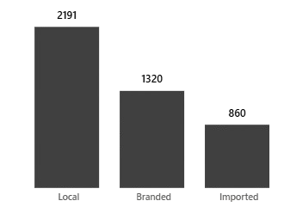
Revenue by Product Category

Slide 7
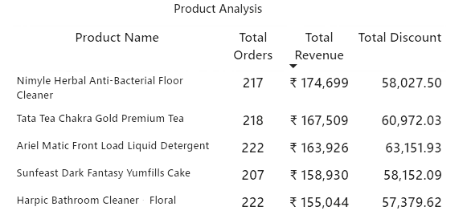
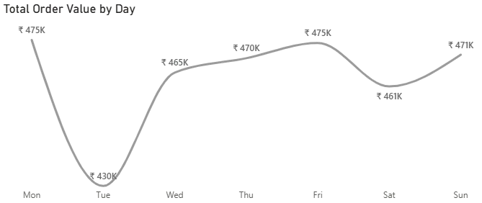
Best Selling Products
Top Performers
Top 5 products contribute 24% of total revenue
Here we see sales on Monday is very high rather
then others

Slide 8
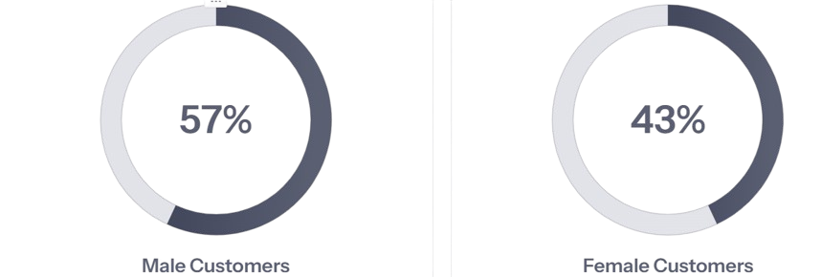
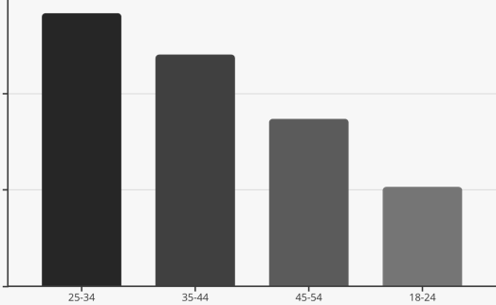
Customer Demographics Analysis
Gender Distribution
Age Group Revenue
male customers drive 57% of revenue and Age 25-34 represents highest-value segment for personalized marketing.

Slide 9



Website & Shopping Behavior
65%
10.04m
35%
Engaged Session
Avg .Time on Site
Bounce Rate
65% of 4,609 total sessions result in some action
Longer sessions correlate with higher AOV
Opportunity to reduce friction in journey
Key Finding: More engagement directly translates to higher conversion rates. With 4,609 total sessions, streamlining the user experience
is crucial to reduce drop-offs and improve engagement.

Slide 10
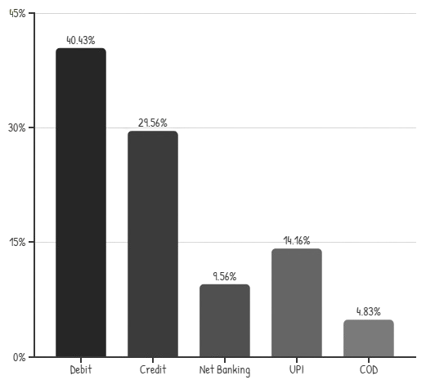
Payment Mode
Payment Mode
Debit and Credit cards account for over 70% of transactions.

Slide 11
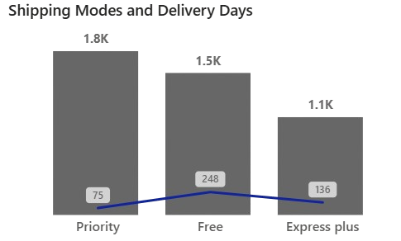
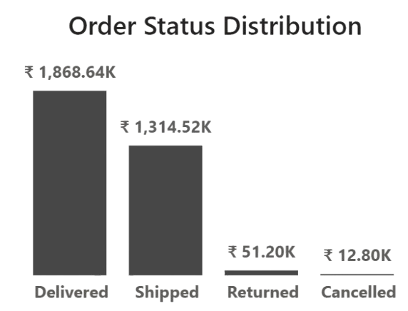
Shipping Mode & Orders status
Most are delivered on time we need to focus on cancelled and returned.
Priority Mode orders have a high demand because it is delivered in less days.
We need to focus on delivery the products in less time to attract more

Slide 12





Data-Driven Recommendations
Improve Delivery
Target 3-day delivery to reduce pending orders
Push Online Payments
Offer 5% cashback to shift from COD
Stock Optimization
Increase inventory for top 10 products
Personalized Marketing
Focus campaigns on 25-34 female segment
Optimize Discounts
Reduce local category discounts by 5%

Slide 13


Dataset
D mart’s Dataset
Dashboard

